Slide 1

INSURANCE

Slide 2
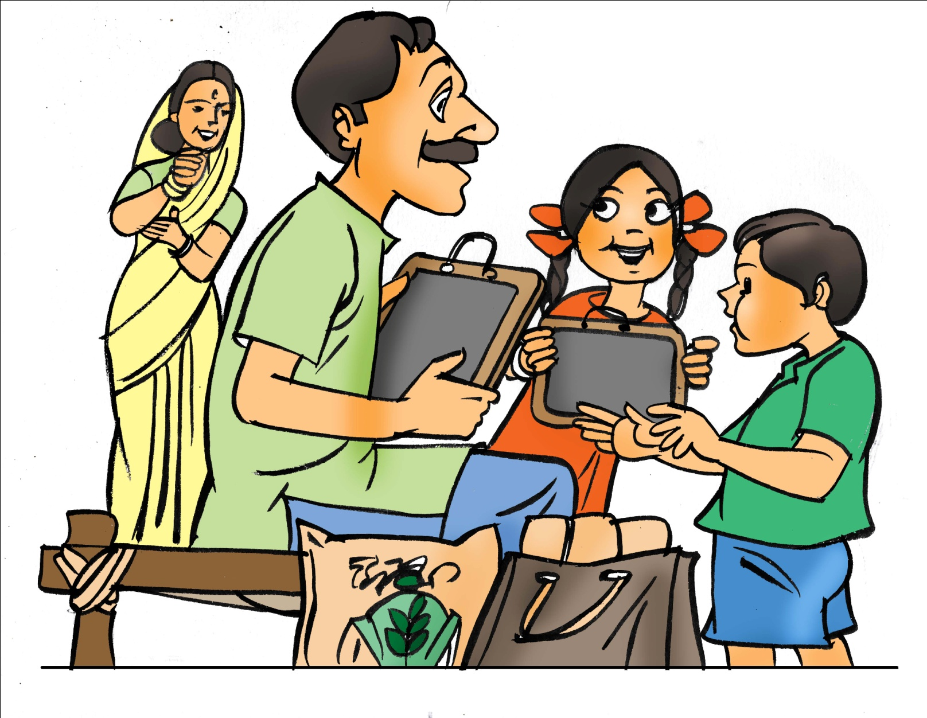
What is Insurance?
My children are doing well in school. But who will look after them if I die?
Something that gives protection against future loss

Slide 3
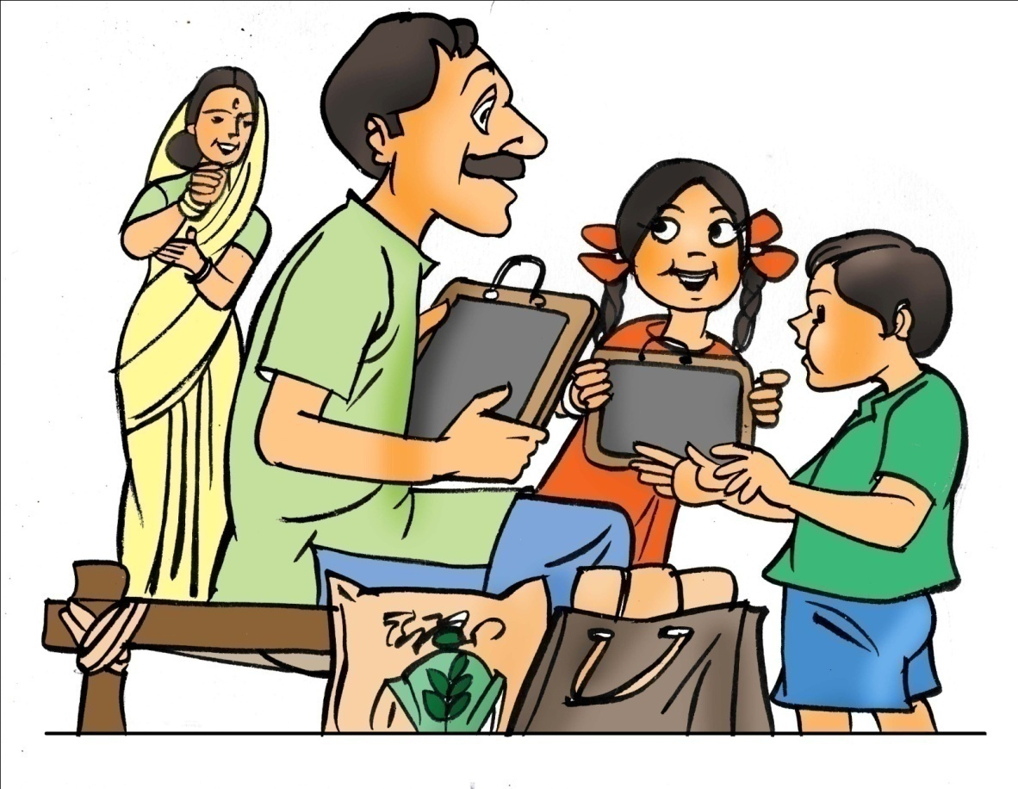
What is Life Insurance?
My children are doing well in school. But who will look after them if I die?
You can buy LIFE insurance. If you die, your family gets the amount you are insured for

Slide 4
Where do I get Life Insurance?
There are Government and non-Government schemes that provide life insurance
Government Schemes:
 | Pradhan Mantri Jeevan Jyoti Bima Yojana | Pradhan Mantri Suraksha Bima Yojana
Offer | 2 Lakh in case of death | 2 Lakh in case of death or disability by accident
Premium | Rs 330 / year | Rs 12 / year
Eligibility | 18-70 years + Bank account in bank that offers scheme | 18-70 years + Bank account in bank that offers scheme
Other term and life insurance policies are also available from LIC and other insurance companies

Slide 5
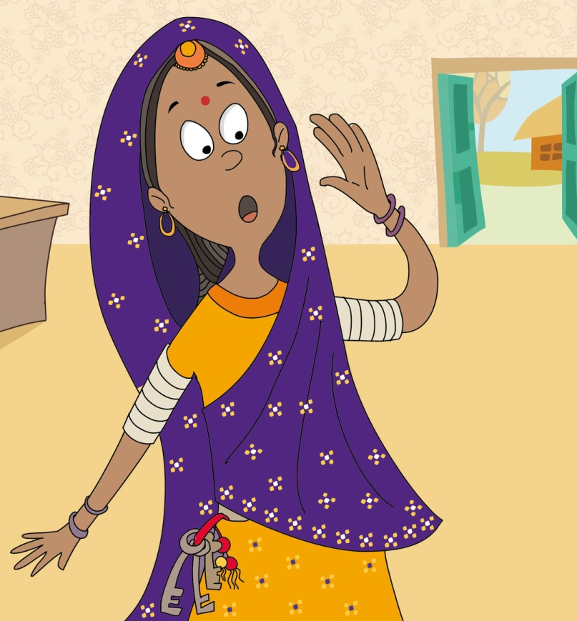
What is Health Insurance?
My son was in hospital and the bill has come to Rs. 40,000! How do I handle this next time?
You can buy HEALTH insurance. This can take care of hospital expenses for illness or surgery

Slide 6
Where do I get Health Insurance?
There are Government and non-Government schemes that provide health insurance
Government Schemes:
 | Rashtriya Swasthya Bima Yojana | Ayushman Bharat
Offer | Rs. 50,000 cover for expenses incurred for hospitalisation for illness or surgery | 5 Lakh per family per year for secondary tertiary medical care
Premium | Rs 700-800 / year | Nil
Eligibility | 18-40 years

Slide 7

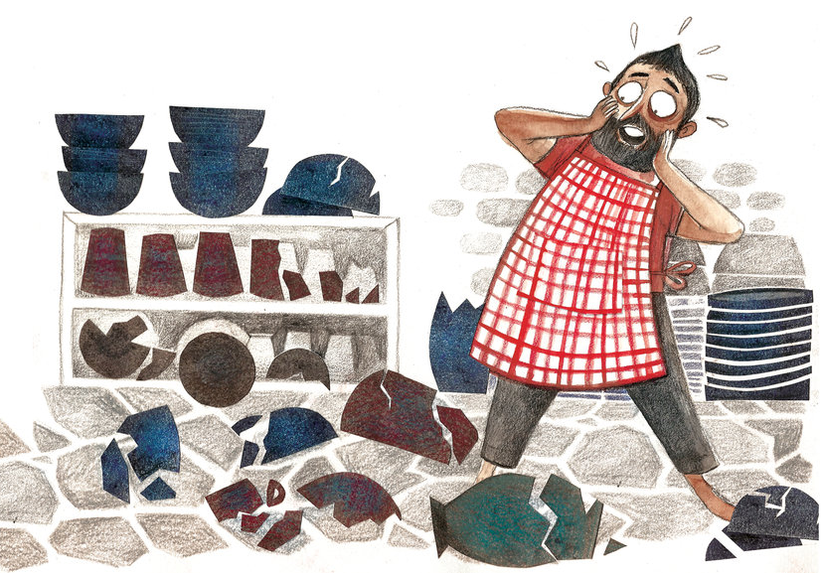
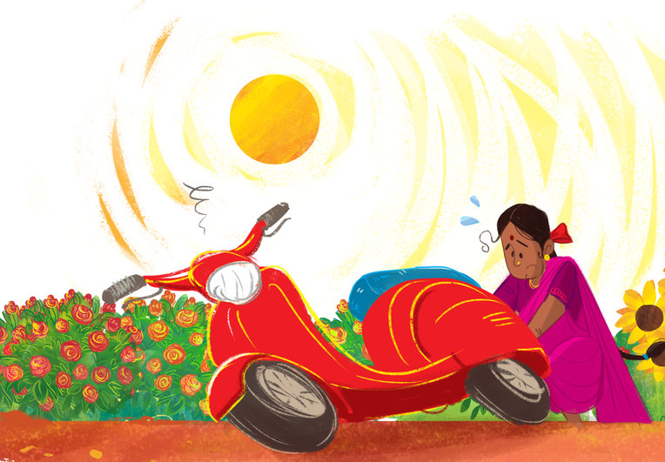
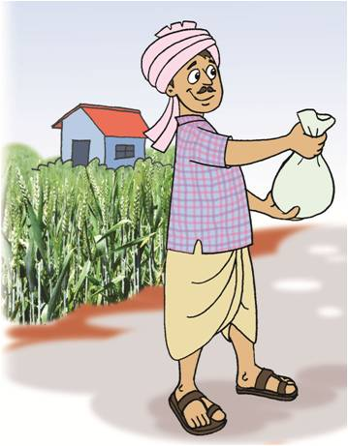
What is General Insurance?
The weather is so unpredictable! What do I do if there is a hailstorm?
Oh no! My scooter is badly damaged. I can’t afford to get it repaired. It’s going to cost Rs. 10,000
How do I protect my home and the things inside it?
You can buy MOTOR insurance. This can take care of damage or theft of your vehicle
You can buy HOME insurance. This can look after your house and the things inside it
You can buy CROP insurance. This can cover natural calamities like hailstorms etc!
Pradhan Mantri Fasal Bima Yojana

Slide 8
Insurance is used to protect yourself and family from losses or calamities that could occur. It is a good idea to understand what kinds of insurance would be helpful for you

